Slide 1

Board Game
1214
Gor Martirosyan
Mikael Elizbaryan

Slide 2
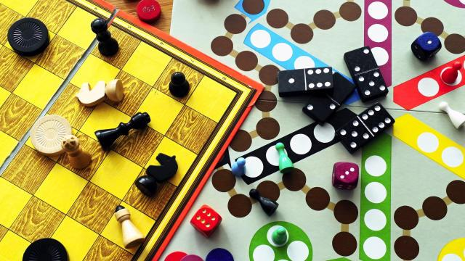
Idea of the Project
Recently I found out that board game <<Zil Zar>> didn't have an application version

Slide 3
Game would have 2 regimes Common and Survival
Survival is new regime which you can play with only 1 team and game ends when you can't score at least 4 points in the round that’s the whole differences
In Common we have 2 teams but now wins team which would get 25 points faster.

Slide 4



4 Minigames
Classic Taboo(Alias)
sailA
Without noises
Yes / No

Slide 5
What I'm thinking to add
1st and only one <<Krokodil>>

